Slide 1
Optimizing retail marketing costs by classifying customers into unique segments using machine learning
By Vibodh Jadhav and Sneha Chandorkar

Slide 2
Every retail company runs marketing campaigns to provide exposure to their products. Significant amount of capital is spent in running these campaigns. In this project, we aim to reduce this capital to the minimum by predicting which customer is most likely to respond to the campaigns.

Slide 3
In this case, the company runs 5 consecutive campaigns. We look at the response to the campaigns. We take our focus off from the type of customers who don’t respond to all the campaigns consistently which reduces the spending on marketing. The ML algorithm decides this ‘type’ of customer from the training dataset.

Slide 4
Approach: Classification. We use binary feature of Campaign response as the target feature/variable( dependent variable ) and select the most important features using EDA( Exploratory Data Analysis )

Slide 5
Features | Details
ID | Customer's unique identifier
Year_Birth | Customer's birth year
Education | Customer's education level
Marital_Status | Customer's marital status
Income | Customer's yearly household income
Kidhome | Number of children in customer's household
Teenhome | Number of teenagers in customer's household
Dt_Customer | Date of customer's enrollment with the company

Slide 6
Features | Details
MntFruits | Amount spent on fruits in last 2 years
MntMeatProducts | Amount spent on meat in last 2 years
MntFishProducts | Amount spent on fish in last 2 years
MntSweetProducts | Amount spent on sweets in last 2 years
MntGoldProds | Amount spent on gold in last 2 years
NumDealsPurchases | Number of purchases made with a discount
Recency | Number of days since customer's last purchase
Complain | 1 if the customer complained in the last 2 years, 0 otherwise
MntWines | Amount spent on wine in last 2 years

Slide 7
Data Preprocessing
Data Cleaning is the first step of Preprocessing. Without good data, the model will not give good results.
We get rid of-
Missing values ( we impute them with mean, here only Income feature has missing values )
Outliers ( we treat outliers by using the IQR method )

Slide 8
Feature Selection
Feature selection is one of the most important steps of the workflow. It significantly boosts the predictive power of the ML algorithms.
We do a three fold analysis for selecting the features-
Univariate analysis by Visualization
Bivariate analysis by Visualization
Bivariate analysis using hypothesis testing( Z test )

Slide 9
Univariate analysis
We do univariate analysis to see whether is feature is normally distributed or not.
Let us look at the graphs-

Slide 10
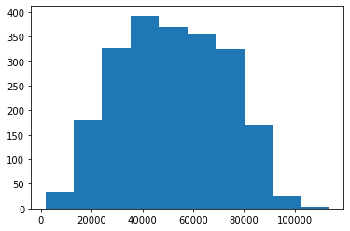
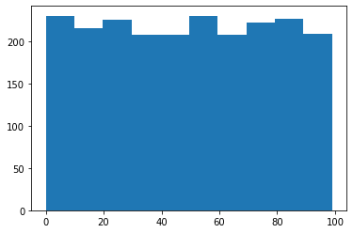
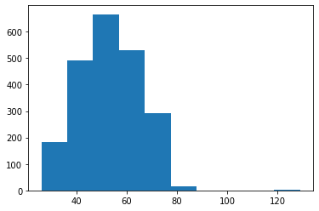
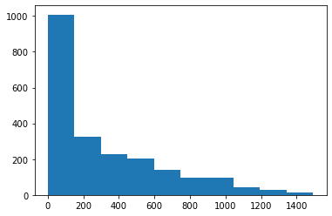

Slide 11
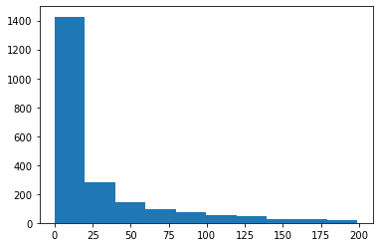
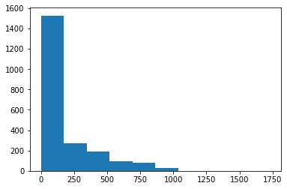
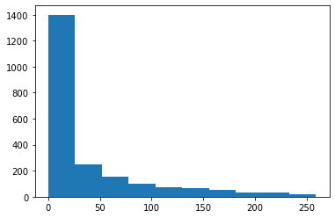

Slide 12
Bivariate analysis using Visualization
Bivariate analysis is used to understand the relationship between the binary target variable of Campaign response and the all the other features. This helps in feature selection. Let us look at the graphs-

Slide 13
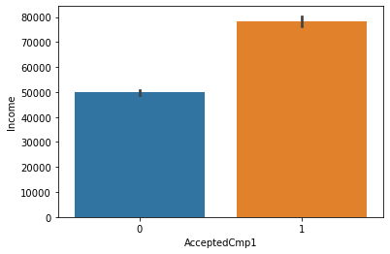
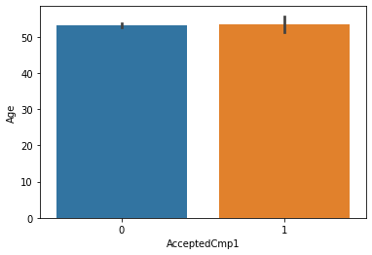
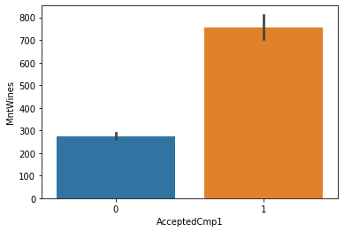
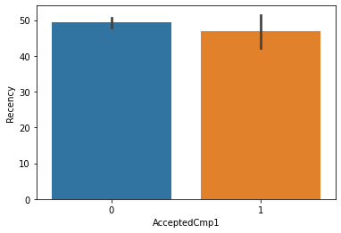

Slide 14
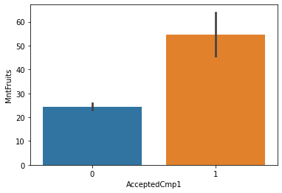
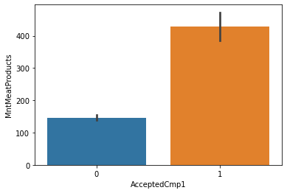
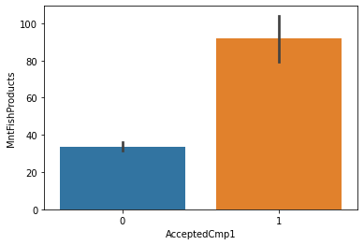


Slide 15
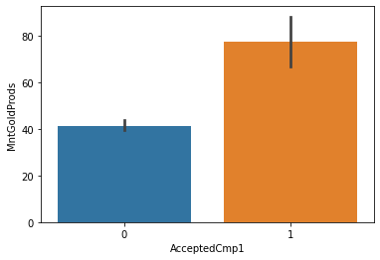
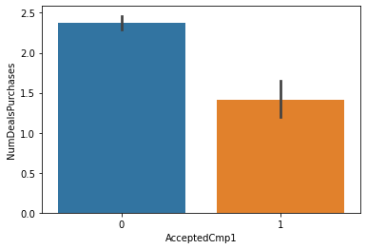
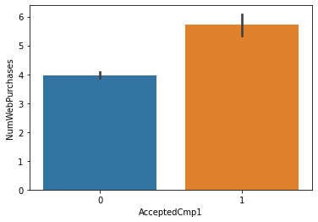
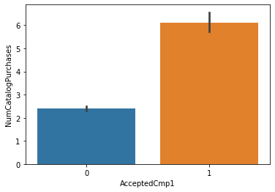

Slide 16
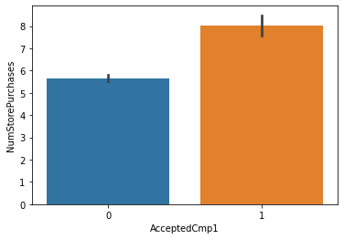
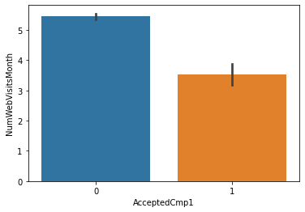

Slide 17
Bivariate analysis using hypothesis testing
Visualization is not enough! Sometimes the relationship between two variables is influenced by another hidden variable(s). To confirm the relationship, we use statistical hypothesis testing with the Z test.
Here, the null hypothesis is- The difference of average between the two groups( for eg- income group who responded to the campaign and income group who didn’t respond to the campaign ) is zero.
The alternate hypothesis is- The difference is significant.

Slide 18
For 95% significance, we will choose the features whose z score>1.96 OR z-score<-1.96( implying p-value<0.05). Even after choosing from them, we will reduce the number of features for the model(s) to improve their predictive power.

Slide 19
Z score = 26.39877661434138
Z score = 0.1635561091405724

Slide 20
Z score =1.0236788760355076
Z score =16.6105544305937

Slide 21
Z score = 6.439549296080812
Z score =12.47005085368447

Slide 22
Z score =9.239671900500861
Z score =8.613626999807142

Slide 23
Z score =6.443338308243719
Z score =-7.802102004939067

Slide 24
Z score =9.020796919605909
Z score =16.85259431730384

Slide 25
Z score =10.054476335338265
Z score =-10.80507967575157

Slide 26
Scaling
We scale the continuous features so that the model doesn’t get biased towards the features that have values larger in scale. For eg- Income and MntWines( Amount spent on Wine by the customer in the last 2 years )

Slide 27
Encoding of categorical variables
We use label encoding to encode the two important categorical variables in this dataset-
Education
Marital_Status

Slide 28
Model fitting
We split the training and test dataset in the ratio 75:25.
We use the following Machine learning algorithms for classification-
Logistic Regression
Decision Tree
KNN
SVM

Slide 29
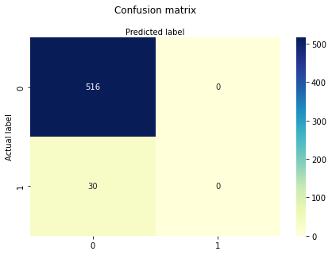
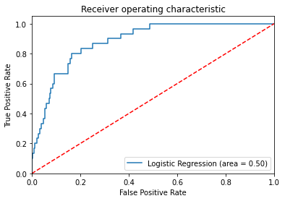
Model Evaluation
Logistic Regression

Slide 30
Model evaluation
Decision Tree

Slide 31
Evaluation metric
Here, we use accuracy as a metric to decide which model is giving us the best results-
Model | Accuracy
Logistic Regression | 0.945054945054945
Decision Tree | 0.9194139194139194
KNN | 0.9432234432234432
SVM | 0.945054945054945

Slide 32
We can see that SVM and Logistic Regression are giving the best results so they will be our preferred models for the predicting the campaign responses for the remaining 4 campaigns using the same methods.

Slide 33
Thank you!

